Slide 1
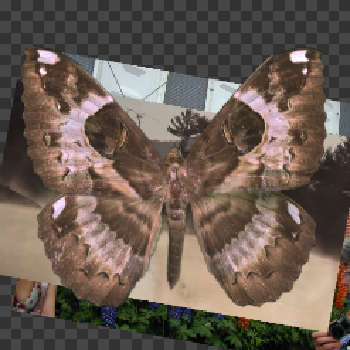
Texture Operators (TOPs) Part 2
David Meredith
dave@create.aau.dk

Slide 2
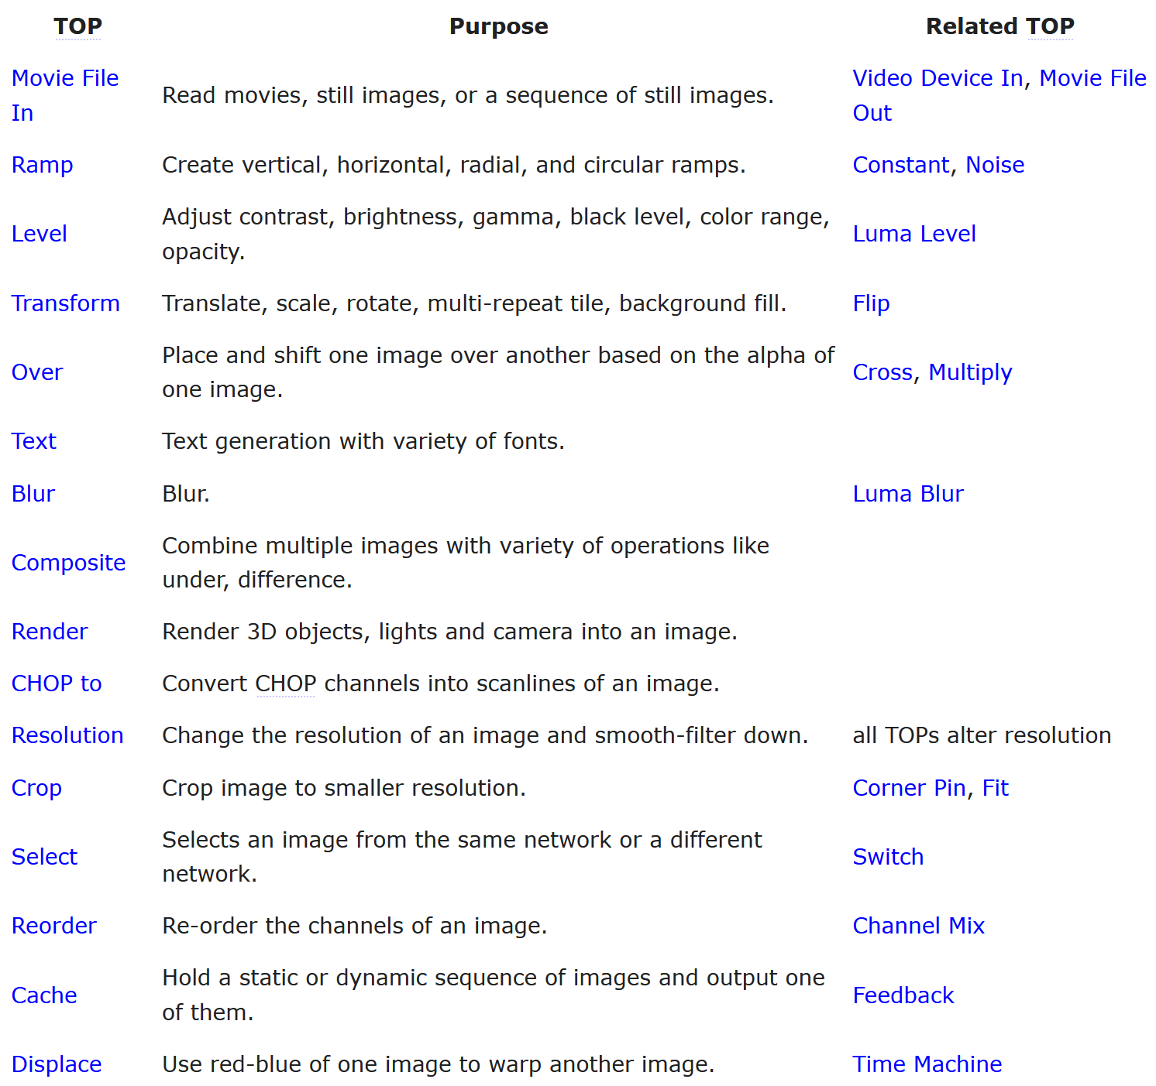
Sweet Sixteen TOPs https://docs.derivative.ca/TOP#Sweet_16_TOPs
The Sweet Sixteen TOPs are a set of 16 TOPs that are commonly used
In this lecture, we’ll cover the TOPs in the shaded region above

Slide 3
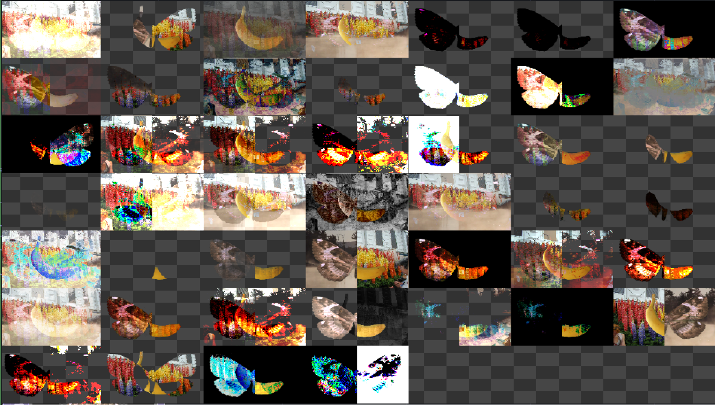
Composite TOP https://docs.derivative.ca/Composite_TOP
Multi-input TOP that performs a composite operation for each input
You select the composite operation using the Operation parameter on the Composite parameter page
Composite page:
TOP: In addition to all inputs attached, you can specify more using the TOPs listed in this field
e.g., ramp* composites all TOPs whose names start with “ramp”
Preview Grid: Shows effect of all operation types in a grid, with inputs swapped on the right side of each tile
Select Input: bypasses composites and lets just one input through
Input Index: Specifies the index of the input to let through when using Select Input
Operation: Menu for choosing which composite operation to perform
Swap Operation Order: Reverses order of operands
if operation is commutative (e.g., add), then order doesn’t matter, otherwise it does (e.g., Over, Hard Light)

Slide 4
Composite TOP – Transform Page https://docs.derivative.ca/Composite_TOP
Transform page (see effects with Over and Butterfly as Fixed Layer)
Fixed Layer: Selects which input to use as the fixed layer
Other layers are overlays – overlays are adjustable by the parameters on the Transform page
Order of composite is not changed
Resolution and aspect ratio of Fixed Layer is used in final result
Pre-Fit Overlay: Determines how overlay fills composite
Justify Horizontal/Vertical: Specify alignment of overlay
Extend Overlay: Sets extend/repeat conditions of overlay
Rotate: Rotates overlay (+ve is clockwise)
Translate: Translates overlay, Translate Units determines how numbers are interpreted
Scale: Scales overlay layer
Pivot: Defines center of enlargement and rotation, works with Pivot Units
Translate Step: Each overlay is translated relative to the previously applied one by the specified amount, works with Translate Step Units

Slide 5
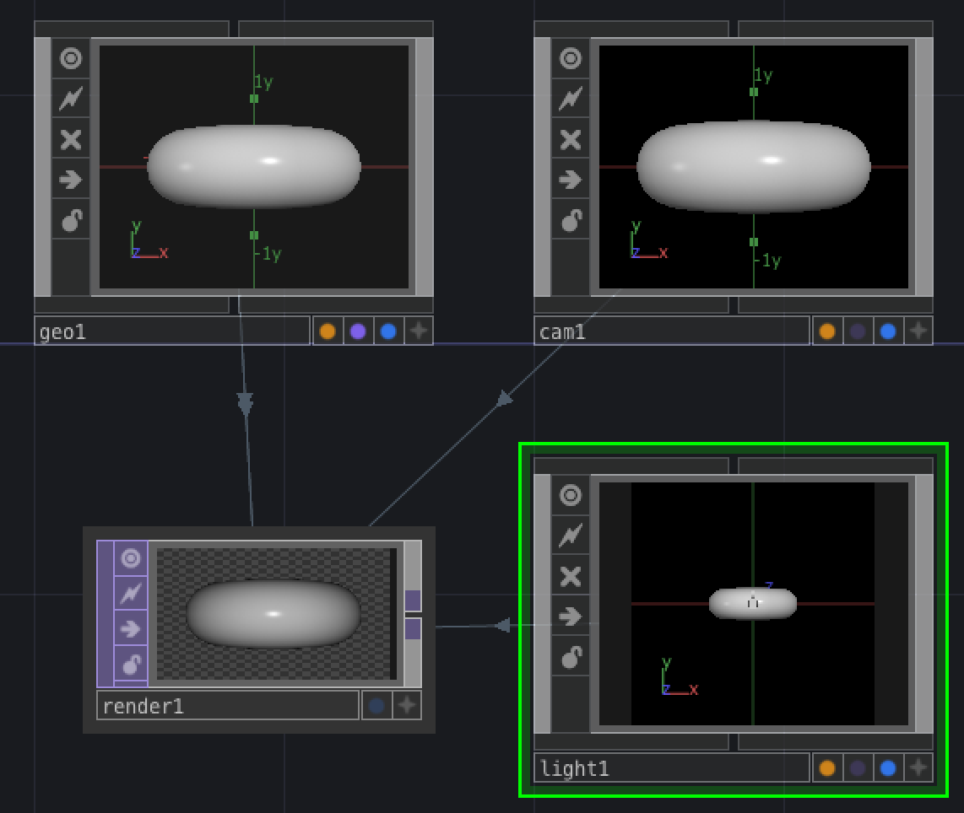
Render TOP https://docs.derivative.ca/Render_TOP
Used to render all 3D scenes
Needs to be given a Camera node and a Geometry node as a minimum
Typically also use Light nodes
Geometry object needs to have a Material assigned to it
Material can be either a pre-packaged MAT or an OpenGL GLSL shader
All textures and bump maps in TD are TOPs that have to be read in using Movie File In TOPs
Render TOP renders in many RGBA and single-channel formats – 8-bit fixed-point up to 32-bit floating point per pixel component
Renders transparent surfaces correctly using Multi-Pass Depth Peeling
See “Order Independent Transparency”
Render TOP can render multiple cameras in a single node
Multiple cameras are specified in one Camera parameter
Render Select TOP can be used to pull out camera results
Supports GPU acceleration

Slide 6
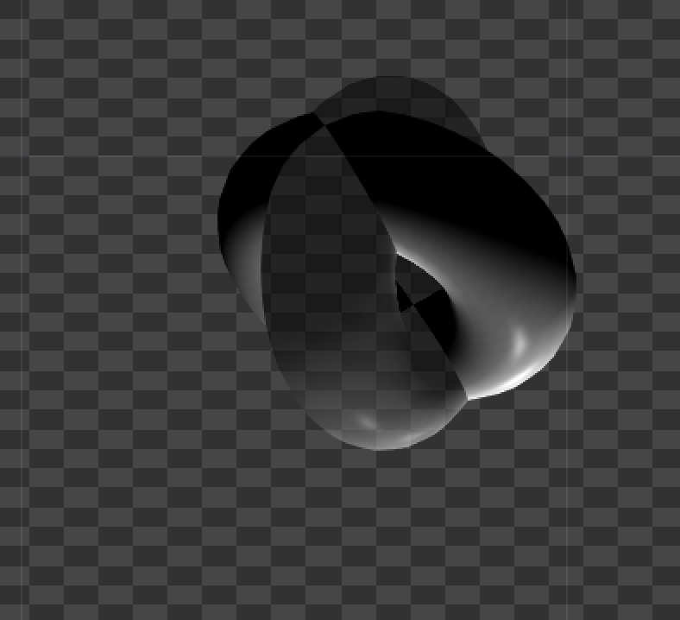
Render TOP – Render Page https://docs.derivative.ca/Render_TOP
Camera(s): Specifies which Cameras to look through when rendering the scene
Can specify multiple cameras and retrieve each one using the Render Select TOP
Multi-Camera Hint: Helps Render TOP optimize rendering when using multiple cameras – controls Multi-Camera Rendering behaviour for this node
Nvidia calls Multi-Camera Rendering “Simultaneous Multi-Projection”
Geometry: Specifies which Geometry will be used – can have multiple Geometry objects and you can specify them using regular expressions (e.g., “geo* ^geo7” = all objects whose name starts with “geo” except geo7)
Lights: Specifies which Lights to use - can also use regex to specify a pattern to select the Lights to use
Anti-Alias: Sets level of anti-aliasing (higher values use more graphics memory)
Render Mode: For rendering various projections – normal 2D, Cube Map, Fish Eye (180), Dual Paraboloid
Cube Map renders 6 views as required for an environment map in the Phong MAT and Environment Light COMP
Dual paraboloid mapping is a technique for generating an environment map that only requires 2 passes, compared with the 6 passes required for a Cube Map
Positive/Negative Sides: Specifies which sides of the cube are rendered +/-X, +/-Y and +/-Z when using Cube Map
UV Unwrap Coord: Select which Texture Layer the coordinates are rendered to when Render Mode is UVUnwap Coord
Used when producing a UV map

Slide 7
Render TOP – Render Page > Transparency https://docs.derivative.ca/Render_TOP
Helps with rendering transparent geometry in proper depth order
No need to sort geometry based on distance from camera
Multi-pass process where each pass processes surfaces that are progressively further and further away from the camera
Turning on transparency disables some advanced features in the Render TOP, including anti-aliasing
Pixel based approach, so not dependent on number of objects but rather on how they are layered
Uses Depth Peeling: First render normal frame, then peel away all pixels seen in the first frame, revealing pixels underneath; then peel away pixels seen in second frame and so on. Finally composite layers Over each other, starting at the deepest layer
e.g., two passes for a hollow sphere: first pass does outer surface, second pass does inner surface
If you have 10 spheres in front of each other than may need up to 20 passes; if the spheres do not occlude each other, then only need 2 passes
Typically don’t need so many passes to get an acceptable rendering – note that each pass is a full rendering so can take significant time

Slide 8
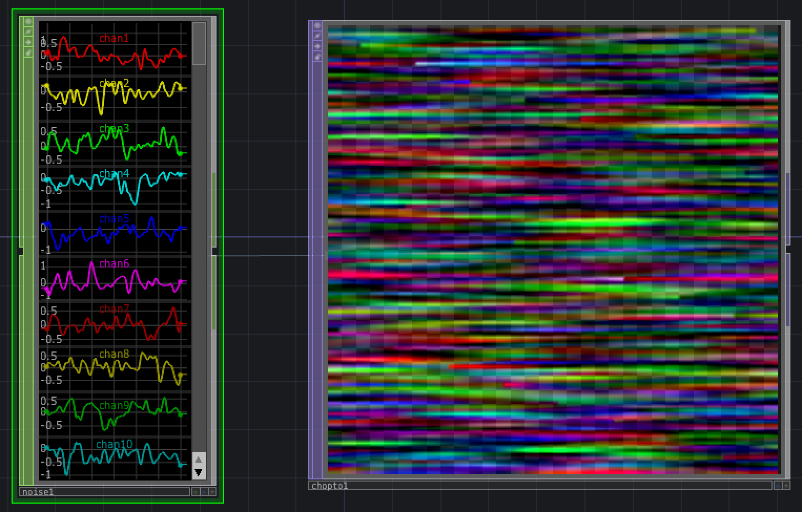
CHOP To TOP https://docs.derivative.ca/CHOP_to_TOP
CHOP To TOP puts CHOP channels into a TOP image
32-bit floating point
Data Format parameter determines how input channels are converted to pixel colors
If Data Format is ‘R’ then each channel is interpreted as the R pixel values for a separate row in the image
If Data Format is ‘RGBA’, then each set of 4 consecutive channels are interpreted as the R, G, B and A channels of pixels for a single row
Image Layout parameter controls how pixel rows are arrangd in the output
By default, image width = number of samples in CHOP; and height is number of channel sets
If channel length > image width, then wrapped layout option can be used to continue channel data onto additional pixel rows
Fit to Square determines a square image resolution that uses all the values in the channels

Slide 9
CHOP To TOP – CHOP to TOP Page https://docs.derivative.ca/CHOP_to_TOP
CHOP: The path of the CHOP being referenced
Data Format: determines how input CHOP channels will be turned into an image
Clamp CHOP Values: Clamps CHOP values to range 0-1
Image Layout: Controls the dimensions of the output image and how CHOP samples are arranged as pixels
Extra Pixel Values (RGBA): Values used to fill in pixel values in image when there are not enough values in the CHOP data

Slide 10
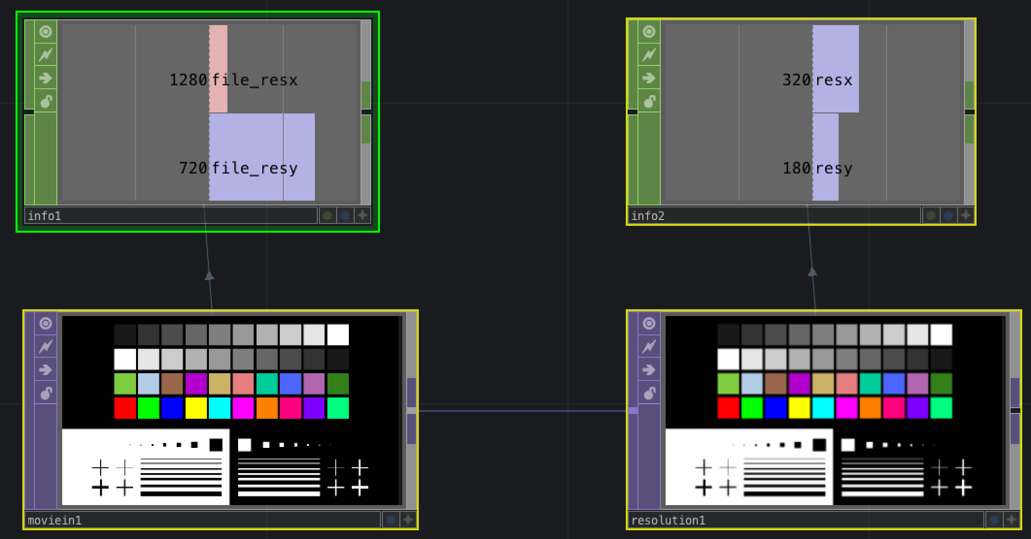
Resolution TOP https://docs.derivative.ca/Resolution_TOP
The Resolution TOP changes the resolution of a TOP image
This can also be done on the Common Page of most other TOPs
High Quality Resize Parameter uses weighted averages of multiple-pixels when scaling down the image

Slide 11
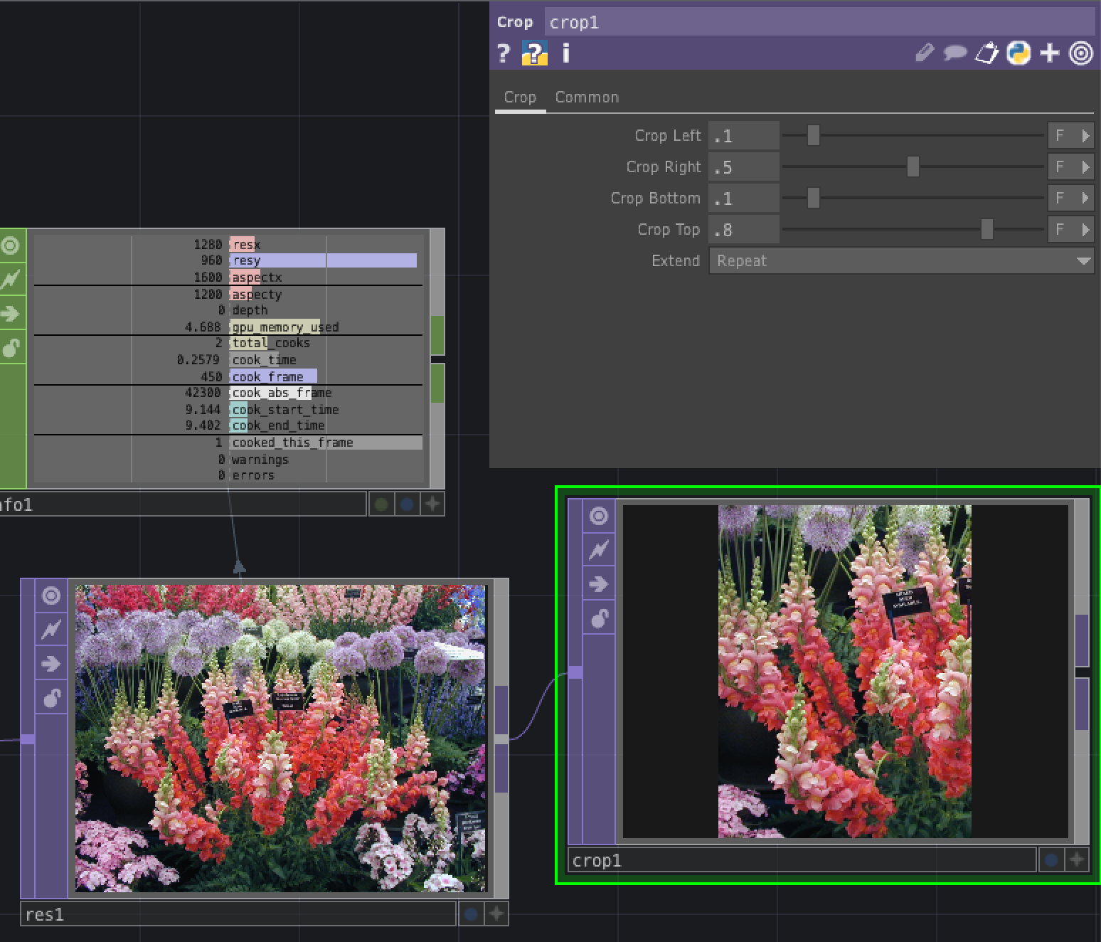
Crop TOP https://docs.derivative.ca/Crop_TOP
Crops image by specifying left, right, bottom and top edges
You can also specify how image is extended

Slide 12
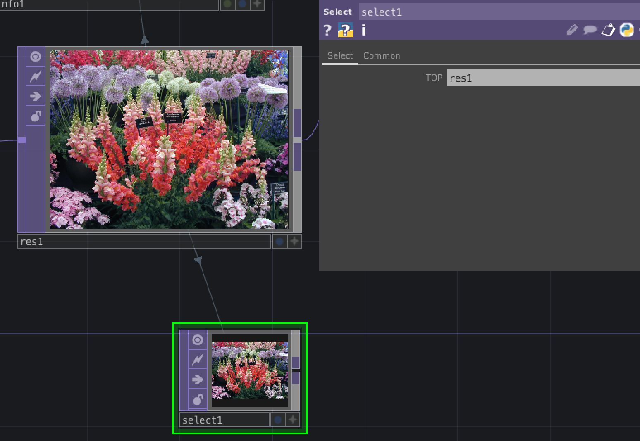
Select TOP https://docs.derivative.ca/Select_TOP
Select TOP allows you to reference a TOP from any other location in TouchDesigner
The TOP parameter contains the path of the TOP being referenced

Slide 13
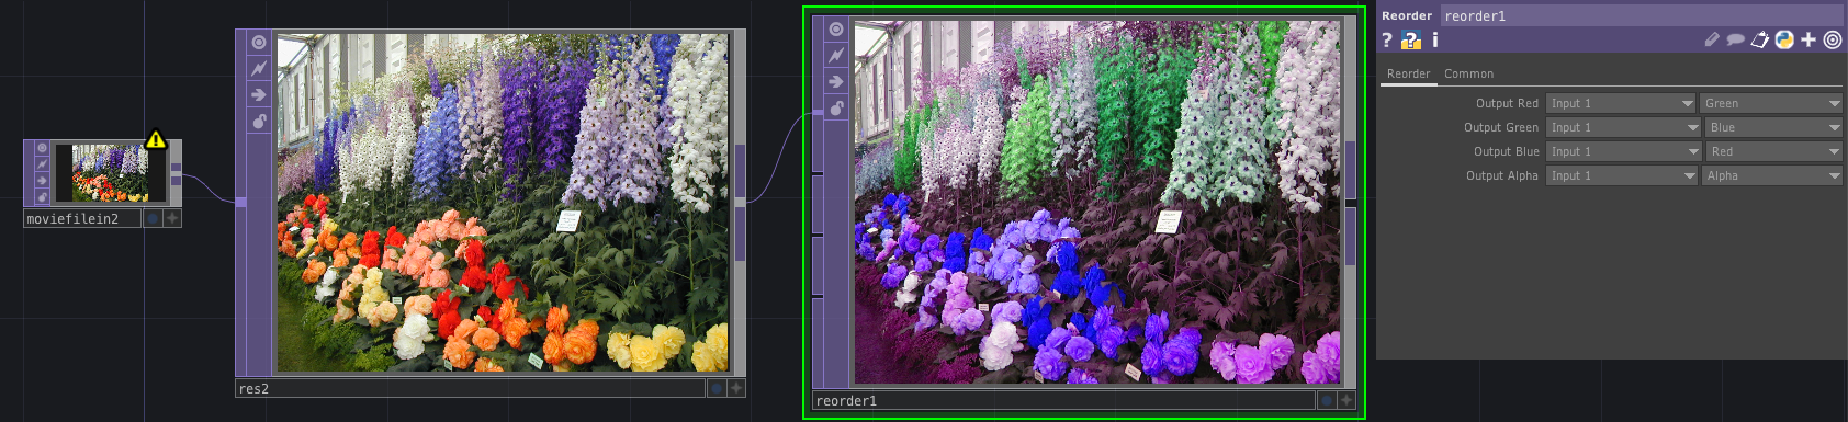
Reorder TOP https://docs.derivative.ca/Reorder_TOP
Multi-input TOP that lets you choose any of the input channels for the R, G, B and A output
Allows you to give several images as input
You can also choose zero, one or the input luminance for any of the output channels.

Slide 14
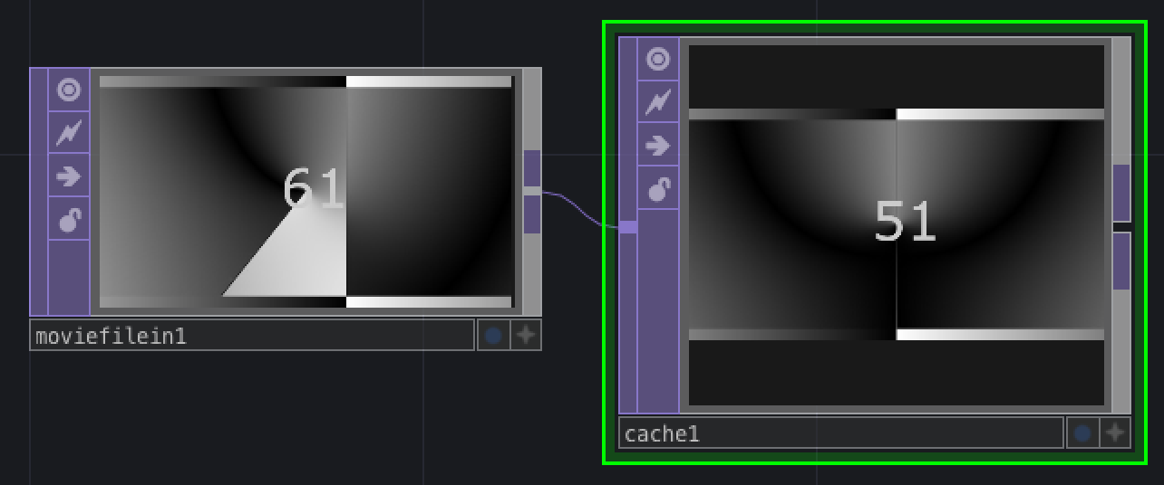
Cache TOP https://docs.derivative.ca/Cache_TOP
Cache TOP stores a sequence of images in GPU memory
These cached images can be read much faster by the graphics card than an image cache in main memory reading off the disk
Can freeze image by turning the Active parameter off
Can create a delay if you set Output Index to a negative value and leave Active parameter On

Slide 15
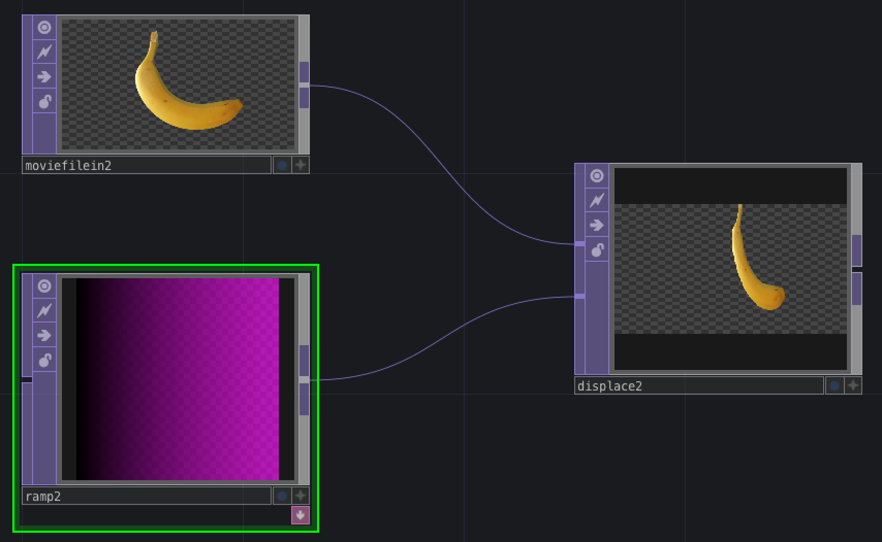
Displace TOP https://docs.derivative.ca/Displace_TOP
Displace TOP causes one image to be warped by another image
Takes two input images – an input image and a displace image
The value of the pixel at (u,v) in the output image is determined by the value of a pixel at a position (x,y) in the input image where x is u displaced using the value of the red channel of the pixel at (u,v) in the input image, and y is v displaced using the value of the blue channel of the pixel at (u,v) in the input image
The value is given by the following expression
Col(Out(u,v)) = Col(In(u * W * (R(Disp(u,v)) – 0.5),
v * W * (0.5 - B(Disp(u,v))))
where W is the Displace Weight

